Slide 1
Hackapizza 2025
Team - LSF

Slide 2
Summary
Problem Description
Solution Description
Design Principles
High Level Architecture
Offline Phase: Knowledge Base Creation
Online Phase: Knowledge Base Querying
Results
Possible Improvements

Slide 3
Problem Description
Goal: develop a “intergalactic food advisor” that can provide the user with a list of suitable dishes based on a question in natural language, which implicitly contains some constraints.
Basic Setting: in the galaxy there are 30 different restaurants scattered around 10 different planets, each with its chef and its unique set of dishes (i.e., menu). Every chef has their own cooking licenses, and every dish is prepared with specific ingredients and cooking techniques.
Additional Info: every cooking technique requires a set of licenses to be performed, some ingredients that contain weird substances cannot exceed a certain thresholds, and there are three different orders to take care of.

Slide 4
Solution Description – Design Principles
Make the System as Predictable and Controllable as Possible.
Combine LLMs with Rule-Based Parsing.
Map Questions to Predefined Sequences of Actions.
Make the System Deployable On-Premises with Limited Resources.
Use “Small“ Open Weights Large Language Models (LLMs).
Focus on Data Quality.
Define a Precise Data Model that Suits the Application.

Slide 5
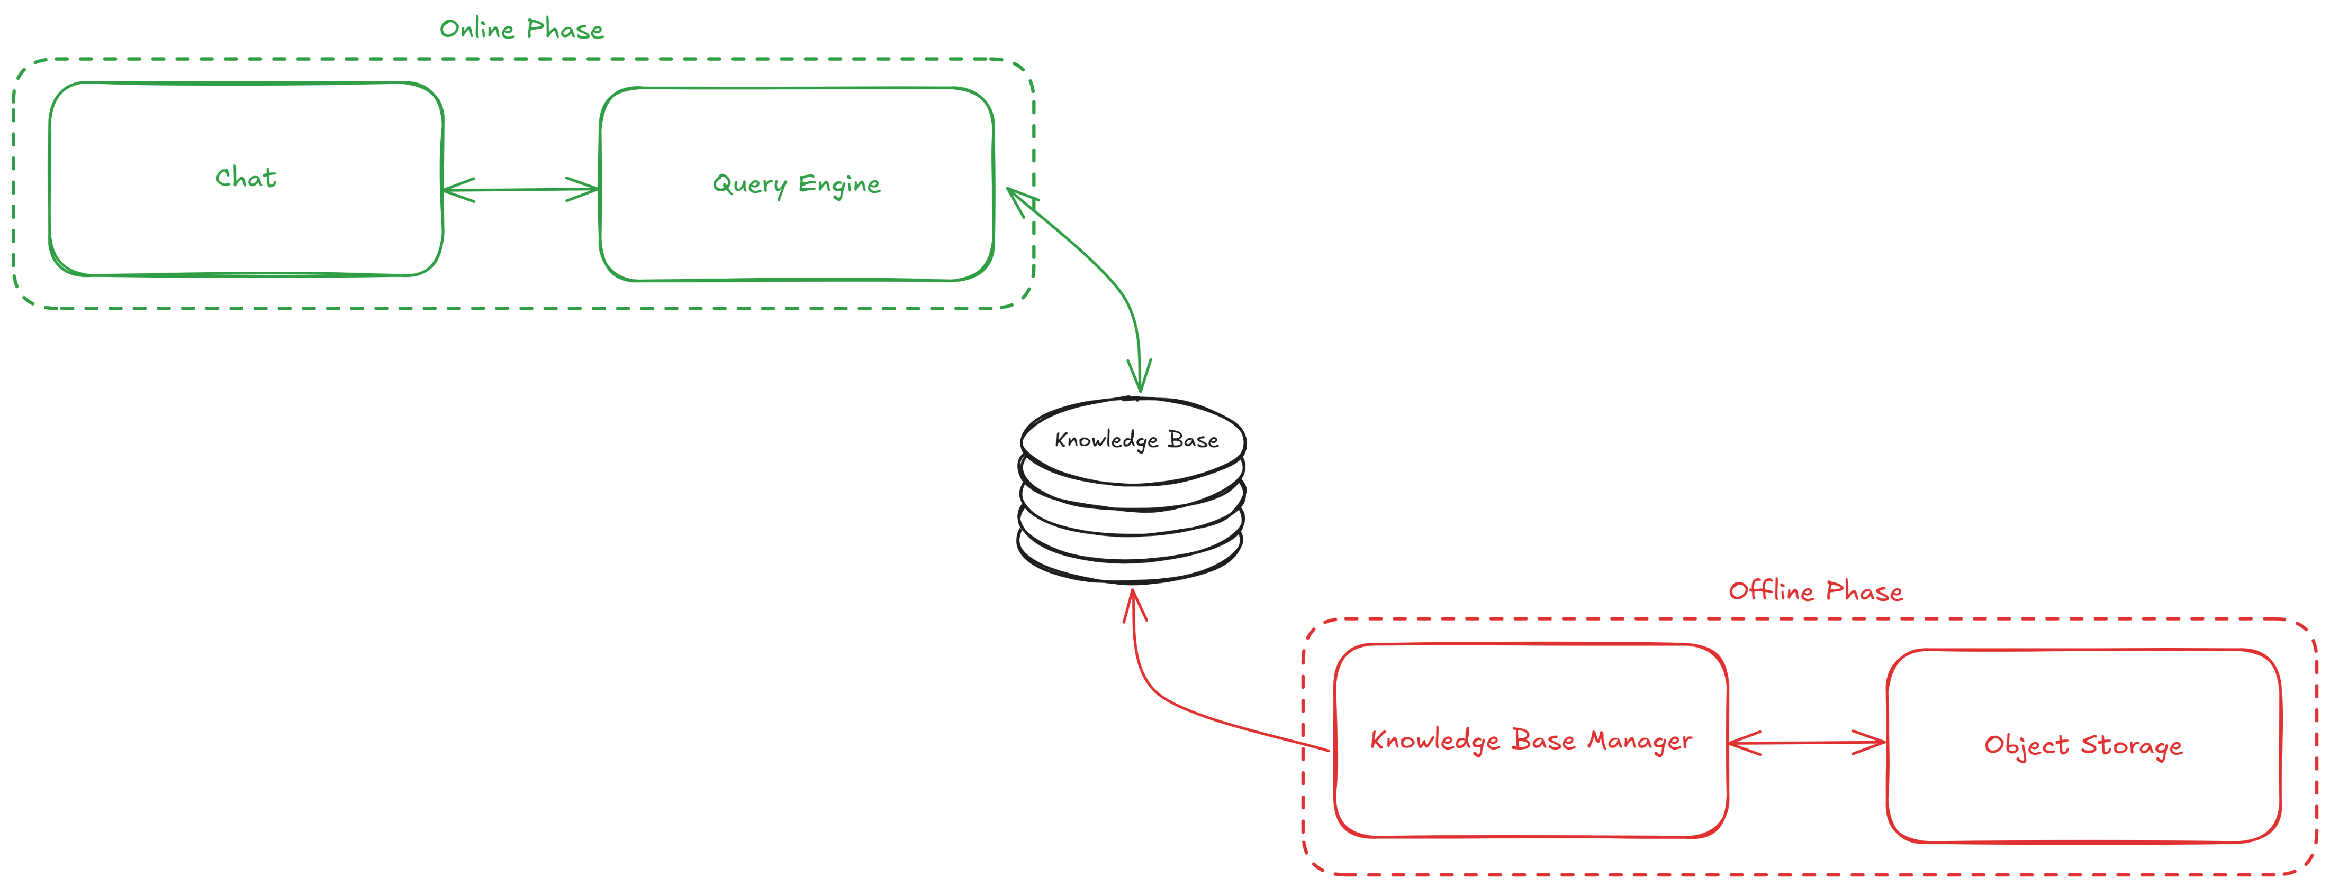
Solution Description – High Level Architecture

Slide 6
Solution Description – Offline Phase (1/1)
Goal: creating the Knowledge Base.
Description: the Knowledge Base Manager (i) reads menus and supporting documents (e.g., cooking manual, intergalactic code of conduct, dish mappings, planets distances, …) from an object storage, (ii) generates for each dish a JSON descriptor that represents it, (iii) and saves it in a document database.
Notes: in this exemplified setting both the object storage and the document database are folders in our repo, but the switch to acutal tools such as MinIO and MongoDB, for instance, is simple.

Slide 7
Solution Description – Offline Phase (1/2)
Data Model: for each dish, we extract the following information.
Restaurant
Name
Planet
Chef
Name
Licenses (Name, Code, Level)
Dish
Code
Name
Ingredients
Techniques (Name, Category, Subcategory)
Orders Info

